Slide 1
TRAFFIC SAFETY
What is traffic safety ? and
What are its objectives ?

Slide 2
Accident Studies and Analysis
The problem of accident is very acute in road transportation due to:
Complex flow pattern of vehicular traffic
Presence of mixed type of vehicles
Presence of pedestrians on the road
Traffic accidents may involve property damage, personal injury and also deaths.
Though road accidents cannot be totally prevented, the percentage of accidents can be decreased by suitable traffic engineering and management methods.

Slide 3
Objectives of accident studies
To study the causes of accidents and to suggest correct treatment at potential locations.
To evaluate existing design regulation and control measures.
To support propose changes in design, regulation and control measures in the selected zone.
To carry out ‘before and after studies’ (BAA) after implementing changes and to demonstrate improvement in accident problems.
To make computations of financial loss due to accidents and
To provide economic justification for the improvement measures suggested by traffic engineer.

Slide 4
Causes of road accidents
There are five basic elements in traffic accident:
Road design and its condition
Road user
Vehicle
Traffic
Environmental factors

Slide 5
Causes of road accidents: Road Design
Defective geometric design like inadequate sight distance on horizontal and vertical curves,
Improper curve design
The vertical curves should be made to blend homogenously with horizontal curves,
Inadequate width of carriage way
Most of the roads are single lane. It is a major cause of accident because of inherent danger on such roads during overtaking and crossing.

Slide 6
Causes of road accidents: Road Design
Shoulder width
Shoulders are needed for parking stopped vehicles, but In India we use it for overtaking
In rainy season they become weak and collapses
Improper lighting and
Improper traffic control devices
Super elevation
deficiency causes serious accidents

Slide 7
Causes of road accidents: Road Condition
The characteristics of road has great influence on the causation of accident.
Pavement Surface Characteristics:
Slippery or skidding road surface, water-logging, potholes, ruts and other damaged conditions of the road surface.
These conditions determine to a large extent the safety of a vehicle when negotiating a curve or when suddenly applying the brakes.
Temporary obstruction to line of sight resulting in reduction of sight distance.
Deficiency in road signs and road markings
Properly designed and maintained road signs inform the driver the need for caution and can avert many accidents
Similarly road marking can also prevent accidents.

Slide 8
Causes of road accidents: The Vehicle
Braking System
Failure of brakes, wheels getting locked while braking (No ABS)
Lighting System
Driving without head light and rear lights at night
4wheelers driving with one head lamp(the other is not working)
Driving with high beam
Direction Indicators
Parking a car on highway shoulder without parking light/stop lamp
Improper usage of dippers
Tires
Puncture and blowouts
Bald tire causes skidding and hydroplaning

Slide 9
Causes of road accidents: The Vehicle
Vehicle body and its features
Shape and dimension of drivers seat
Arrangement of dials on the dashboard
Positioning of controls on the drivers seat
Visibility of driver from the seat
Noise level in the vehicle
Concentration of carbon Monoxide in the vehicle
Blind spots in the vehicle (bonnet and wind screen pillars)
Door locks
Maintenance
Improper maintenance

Slide 10
Causes of road accidents: The Road User – The Driver
The driver is the key factor in the causation of accidents
He drives it, steers it, accelerate and decelerate, stops it.
Driver behavior study offers very deep insights into the cause of accidents and provides valuable guidance for avoidance of accidents.
His behavior influences and controls the vehicle while his behavior itself is controlled by his personality, training and attitudes.

Slide 11
Causes of road accidents: The Road User – The Driver
The task of a driver in a busy street is very taxing. During the course of his driving he has to:
Overtake many vehicles and be overtaken by some
Perform numerous turning maneuvers
Comprehend dangerous situations as they present themselves at intersections etc.
Deal with a number of pedestrians crossing the street here and there
Hence driving is no longer stress free or relaxation recreation but is in fact the generation of an appreciable cardiovascular stress in a driver

Slide 12
Causes of road accidents: The Road User – The Driver
Hence the major causative factors which contributes to accidents because of driver behavior, attitude and training are listed below:
Excessive speed and rash driving
Carelessness
Violation of rules and regulations
Failure to see and understand the traffic situation, sign and signal.
Temporary effects due to fatigue, sleep or effects of alcohol and drugs.
Age and sex of drivers (young and old drivers cause more accidents)
Marital status (married people cause less accidents)
Driver judgement, skill and emotional make-up (PIEV theory) 1) Perception 2) Intellection 3) Emotion 4) Violation. Perception time: is time required for the sensations received by the eyes or ears of the driver to be transmitted to the brain through the nervous system & spinal cord or it is the time required to perceive an object or situation. 2)Intellection time : is the time require for the driver to understand the situation it is also the time required for comparing the different thoughts. 3) Emotion time: is the time elapsed during emotional sensational and other mental disturbance such as fear, anger or any other emotional feeling superstition etc 4) Volitiontime: is the time taken by the driver for the final action such as brake application.
Non usage of safety belts, crash helmets
Airbags not available
Improper training

Slide 13
Causes of road accidents: The Road User – Pedestrians and Passengers
Pedestrians
Violating regulations
Carelessness while using the carriageway meant for vehicles
Passengers
Alighting from or getting into moving vehicles

Slide 14
Causes of road accidents: Weather and others
Unfavorable weather conditions like mist, fog, snow, dust, heavy rainfall, smoke which restrict normal visibility.
Stray animals on roads
Improper sign boards
Badly located advertisement boards.

Slide 15
Accident Studies
The various steps involved in traffic accident studies are:
Collection of accident data
Preparation of accident reports
Preparation of location file
Preparation of diagrams showing the type of collision and
Application of the above records for suggesting measures to prevent similar accidents at the same location.

Slide 16
Collection of accident data (IRC:53-1982)
General: Date, time, persons involved in the accident and their particulars, classification of accidents like fatal, serious, minor, property damage only etc.
Location: description and details of accident supported by diagrams.
Details of vehicles involved: registration number, make and description of vehicles, loading details, vehicular defects

Slide 17
Collection of accident data (IRC:53-1982)
Nature of accident: Condition of vehicles involved, details of collision, pedestrians or objects involved, damages, injuries, casualty etc.
Road condition: Details of road geometrics, whether the road stretch is straight of curved, surface characteristics such as dry, wet or slippery etc.
Traffic condition: Type of vehicles in the traffic flow, traffic volume and density, etc.

Slide 18
Collection of accident data (IRC:53-1982)
Primary cause of accident: Various possible causes and the primary cause
Other probable causes
Accident cost: total cost of accident, such as property damage, personal injuries and casualties, computed in terms of rupees.

Slide 19
Uses of Collection of accident data
The usefulness of an accurate and comprehensive system of collection and recording accident cannot be over-emphasized.
Such data serve to identify the basic causes of accidents and to suggest means for overcoming the deficiencies that lead to such accidents.
The data have a number of uses

Slide 20
Collection of accident data – Engineering uses:
To determine the adequacy, size, shape and legibility of traffic signs.
Justification for traffic control devices, such as traffic signals.
Planning pedestrian safety features such as underpasses, over bridges, pedestrian barriers, refuge islands, pedestrian signals and street lighting.
In determining speed zoning and speed control.
In planning traffic regulation measures such as prohibition of on-street parking, one-way streets and prohibited turnings.

Slide 21
Collection of accident data – Engineering uses:
In designing safe and efficient street lighting
In designing or redesigning intersection.
In designing and providing channelizing islands, central verges and refuge islands.
In planning safety measures for traffic during construction.
In identifying specific deficiencies in the maintenance procedures and specifications.
In improving the horizontal and vertical alignment.

Slide 22
Collection of accident data – Engineering uses:
In providing adequate sight distances.
In determining suitable width for pavement, shoulders and bridges.
In understanding the deficiency of the pavement surfaces and devising ways and means of improving them.
In determining any deficiencies in super-elevation and camber and rectifying them.
In planning safety measures and guard rails.

Slide 23
Collection of accident data – Enforcement uses
In planning deployment of personnel for various duties such as manual control and street patrolling depending upon accident frequency at different locations and during different hours of the day.
In directing enforcement effort.
In controlling pedestrian behavior.
In the safe and efficient operation of traffic control devices.
In enforcing kerb parking regulations.
In planning and enforcing vehicle and cycle inspection measures.
In aiding prosecution of offenders in courts.

Slide 24
Collection of accident data – Administrative and policy issues
In initiating and administering Traffic Safety programmes.
In evaluating the success of Traffic Safety Programmes.
In determining the accident costs.
In identifying the need to amend the legislative measures in force and to take appropriate action to amend them.

Slide 25
Collection of accident data – Uses for the Motor Vehicle Administrator
In reviewing the procedures for licensing drivers.
In reviewing the procedures for registration and licensing of vehicles
In reviewing the vehicles inspections requirement

Slide 26
Collection of accident data - Educational uses
In planning and organizing school safety education programmes.
In planning and organizing driver safety educational programmes.

Slide 27
Accident report
The accident should be reported to police authorities who would further collect required details and take legal action especially in more serious accidents involving injuries, casualties or severe damage to property.
Accident report of individuals involved may be separately taken.
Based on the accident data collected, as discussed in the previous slides, an accident report is prepared with all the facts which might be useful in subsequent analysis, claims for compensation, evaluation of accident cost.

Slide 28
Accident Records
Accident records are maintained giving all particulars of accidents, location and other details.
The record may be maintained by means of:
location files,
spot maps,
collision diagrams and
condition diagrams.

Slide 29
Accident Records Location files
These are used to keep a record of locations where accidents have taken place within the concerned zone and to identify the locations of high incidence.
Location files should be maintained by each police station for the respective jurisdiction.

Slide 30
Accident Records Spot Maps
Accident location spot maps show accidents by spots, pins or symbols on the road map of the locality.
A map of suitable scale may be used for preparation of spot maps of urban accidents.

Slide 31
Accident Records Collision diagram
These diagrams depict the details of accident location and show the approximate path of the vehicles and pedestrians involved in the accidents and also other objects with which the vehicles have collided.
Collision diagrams are most useful to compare accident pattern before and after the remedial measures have been taken.
Typical collision diagram is shown in the next slide.

Slide 32
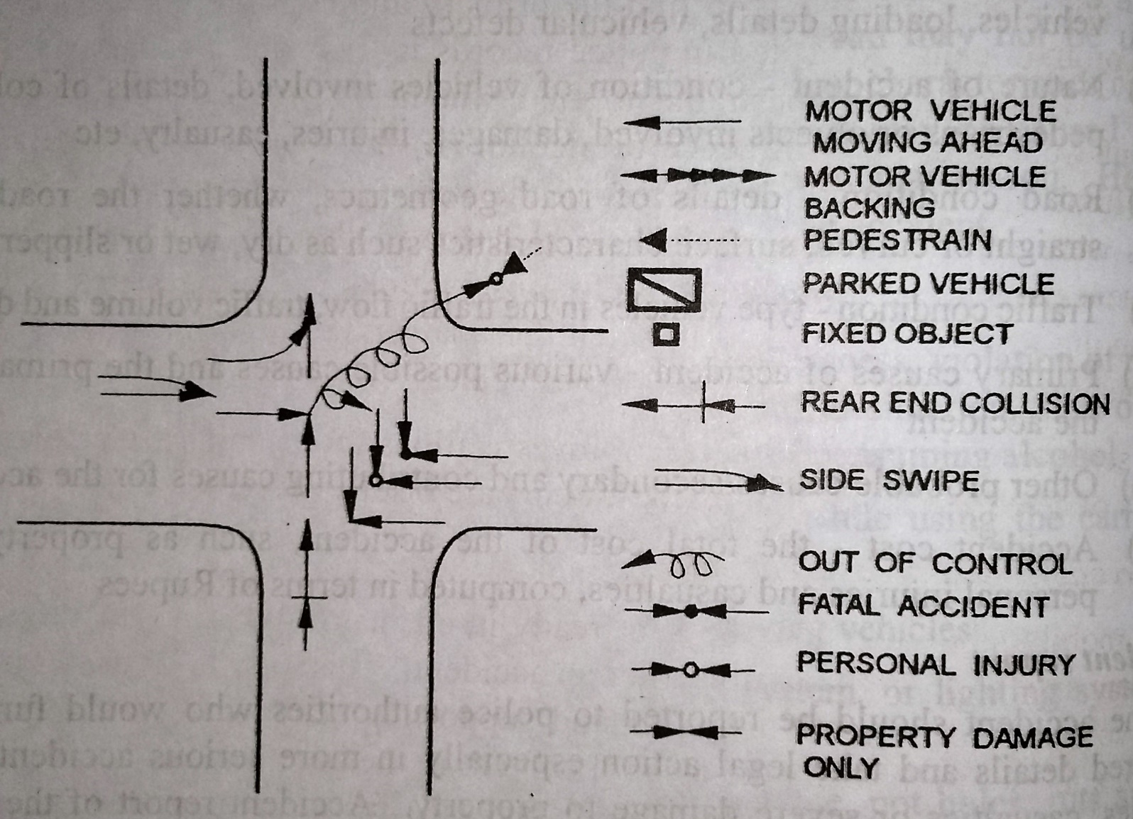
Collision Diagram
Source: Highway Engineering, S.K.Khanna and C.E.G.Justo

Slide 33
Accident Records Condition Diagram
A condition diagram is the drawing of the accident location drawn to scale, showing all the important physical features of the road and adjoining area.
The important features in the condition diagram are:
Geometric features of the road such as width of roadway, shoulders, median if any.
Other geometric details such as curves, kerb lines, bridges, culverts, over bridge and underpass electric posts, trees and
All details of roadway conditions, obstruction to vision, property lines, signs, signals, road side ditches etc.
Parking regulations.
Condition and collision diagrams may be combined together in a single sketch if necessary.

Slide 34
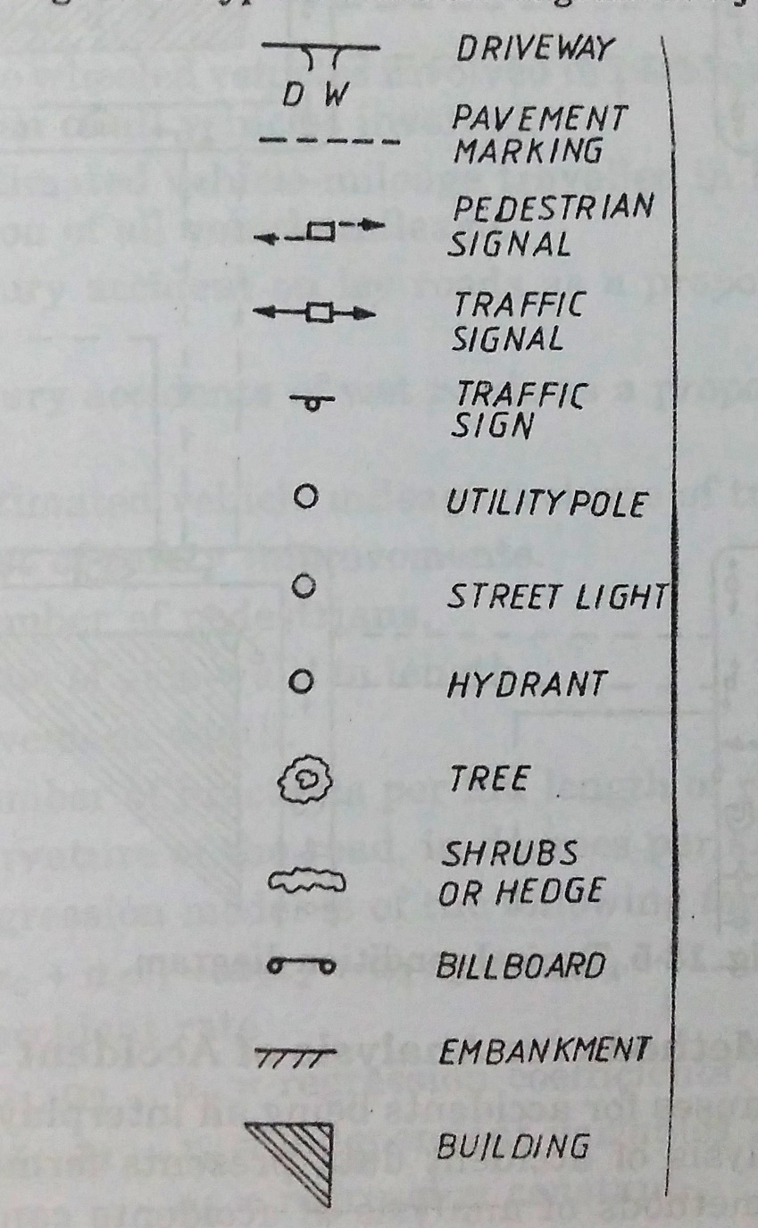
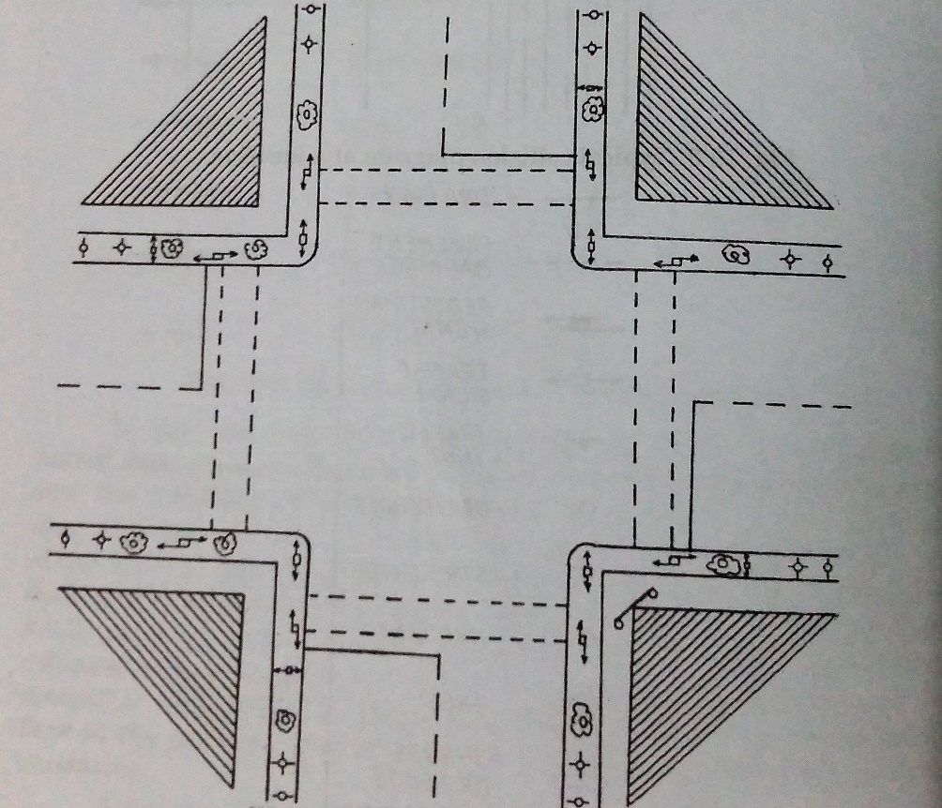
Condition diagram
Source: Traffic Engineering and Transport Planning by L.R Kadiyali

Slide 35
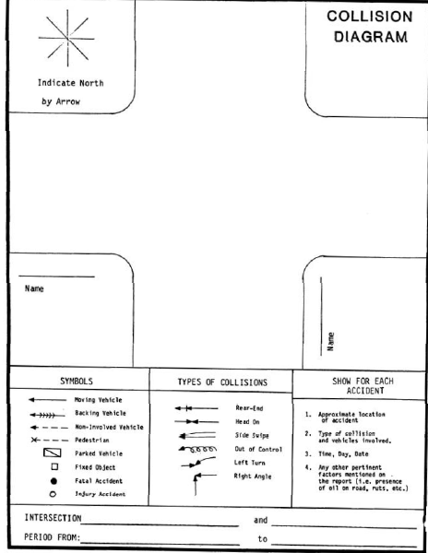
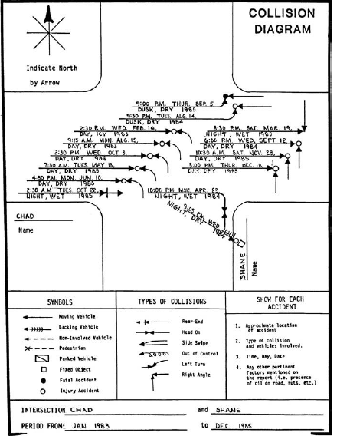
An example for collision Diagram.
Source: Google images

Slide 36
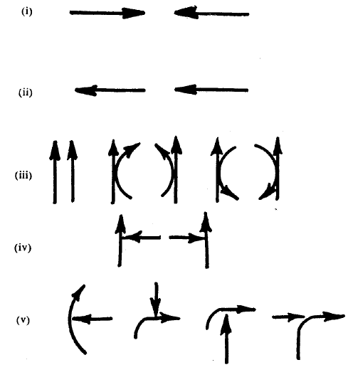
(i) Head on collision
(ii) Rear end collision
(iii) Brush/side swipe
(iv) Right angled collision
(v) Right turn collision

Slide 37
Accident Data Analysis
The accident data collection involves extensive investigation which involves the following procedure:
Reporting:
It involves basic data collection in form of two methods:
(a) Motorist accident report - It is filed by the involved motorist involved in all accidents fatal or injurious.
(b) Police accident report - It is filed by the attendant police officer for all accidents at which an officer is present.
This generally includes fatal accidents or mostly accidents involving serious injury required emergency or hospital treatment or which have incurred heavy property damage.

Slide 38
Accident Data Analysis
2. At Scene-Investigation: It involves obtaining information at scene such as measurement of skid marks, examination of damage of vehicles, photograph of final position of vehicles, examination of condition and functioning of traffic control devices and other road equipment.
3. Technical Preparation: This data collection step is needed for organization and interpretation of the study made. In this step measurement of grades, sight distance, preparing drawing of after accident situation, determination of critical and design speed for curves is done.

Slide 39
Accident Data Analysis
4. Professional Reconstruction: In this step effort is made to determine from whatever data is available how the accident occurs from the available data. This involves accident reconstruction. It is professionally referred as determining behavioural or mediate causes of accident.
5. Cause Analysis: It is the effort made to determine why the accident occurred from the data available and the analysis of accident reconstruction studies.

Slide 40
Accident Investigations
The purpose is to find the possible causes of accident related to driver, vehicle, and roadway. Accident analyses are made to develop information such as:
Driver and Pedestrian - Accident occurrence by age groups and relationships of accidents to physical capacities and to psychological test results.
Vehicle - Accident occurrence related to characteristics of vehicle, severity, location and extent of damage related to vehicles.
Roadway conditions - Relationship of accident occurrence and severity to characteristics of the roadway and roadway condition and changes related to roadways.

Slide 41
Accident Investigations
It is important to compute accident rate which reflect accident involvement by type of highway.
These rates provide a means of comparing the relative safety of different highway and street system and traffic controls.
Another is accident involvement by the type of drivers and vehicles associated with accidents.

Slide 42
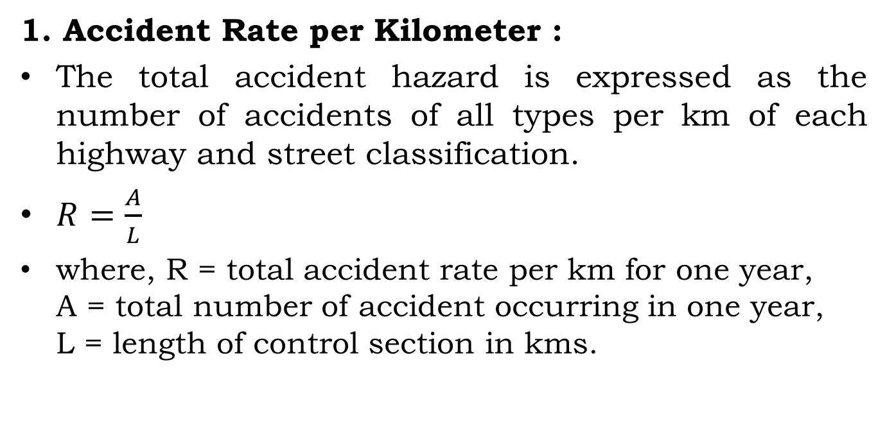
Accident Rate
1. Accident Rate per Kilometer :
The total accident hazard is expressed as the number of accidents of all types per km of each highway and street classification.
$R=\frac{A}{L}$
where, R = total accident rate per km for one year, A = total number of accident occurring in one year, L = length of control section in kms.

Slide 43
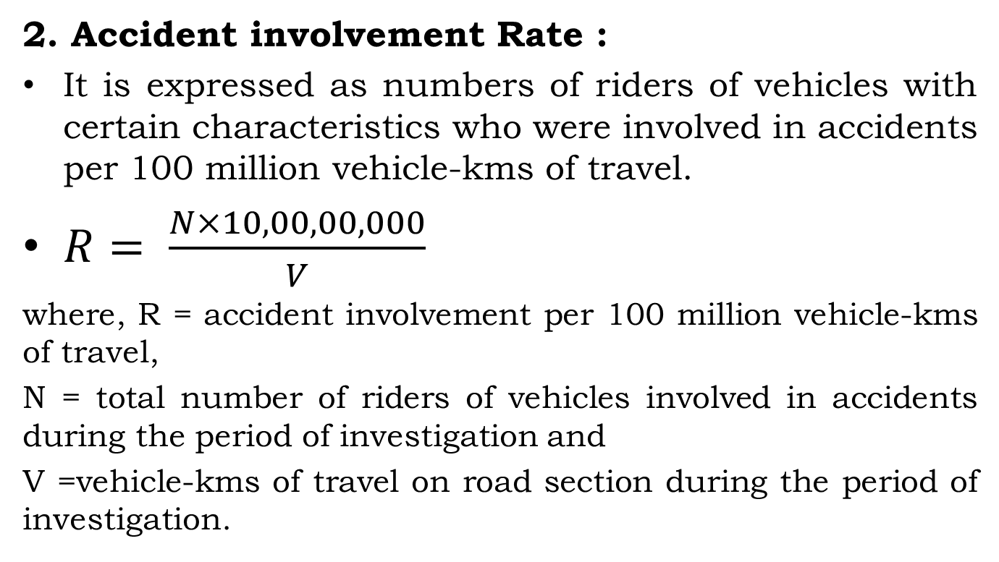
Accident Rate
2. Accident involvement Rate :
It is expressed as numbers of riders of vehicles with certain characteristics who were involved in accidents per 100 million vehicle-kms of travel.
$R= \frac{N×10,00,00,000}{V}$
where, R = accident involvement per 100 million vehicle-kms of travel,
N = total number of riders of vehicles involved in accidents during the period of investigation and
V =vehicle-kms of travel on road section during the period of investigation.

Slide 44
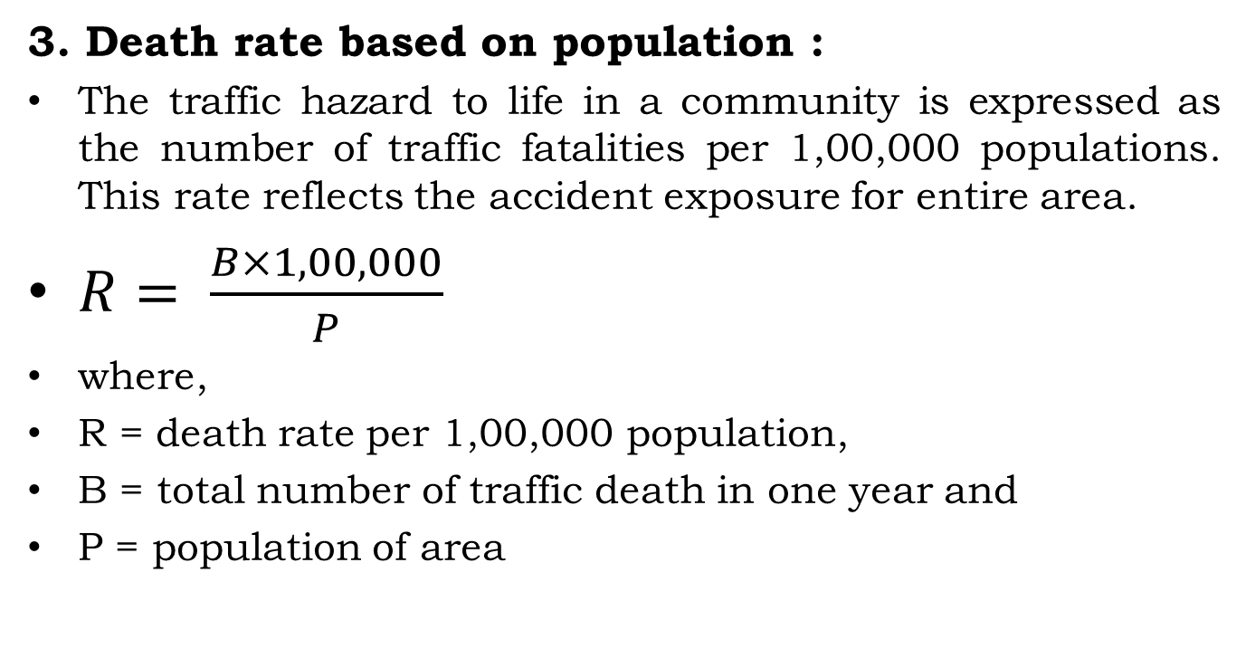
Accident Rate
3. Death rate based on population :
The traffic hazard to life in a community is expressed as the number of traffic fatalities per 1,00,000 populations. This rate reflects the accident exposure for entire area.
$R= \frac{B×1,00,000}{P}$
where,
R = death rate per 1,00,000 population,
B = total number of traffic death in one year and
P = population of area

Slide 45
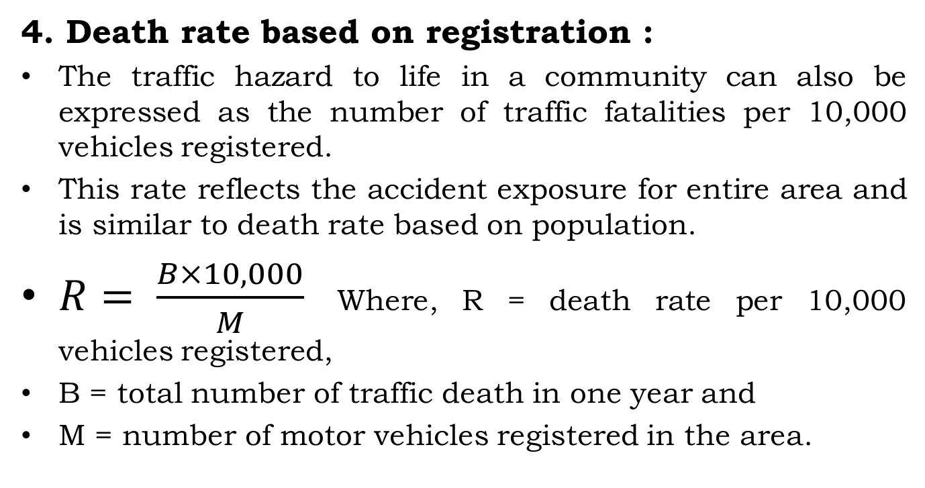
Accident Rate
4. Death rate based on registration :
The traffic hazard to life in a community can also be expressed as the number of traffic fatalities per 10,000 vehicles registered.
This rate reflects the accident exposure for entire area and is similar to death rate based on population.
$R= \frac{B×10,000}{M}$ Where, R = death rate per 10,000 vehicles registered,
B = total number of traffic death in one year and
M = number of motor vehicles registered in the area.

Slide 46
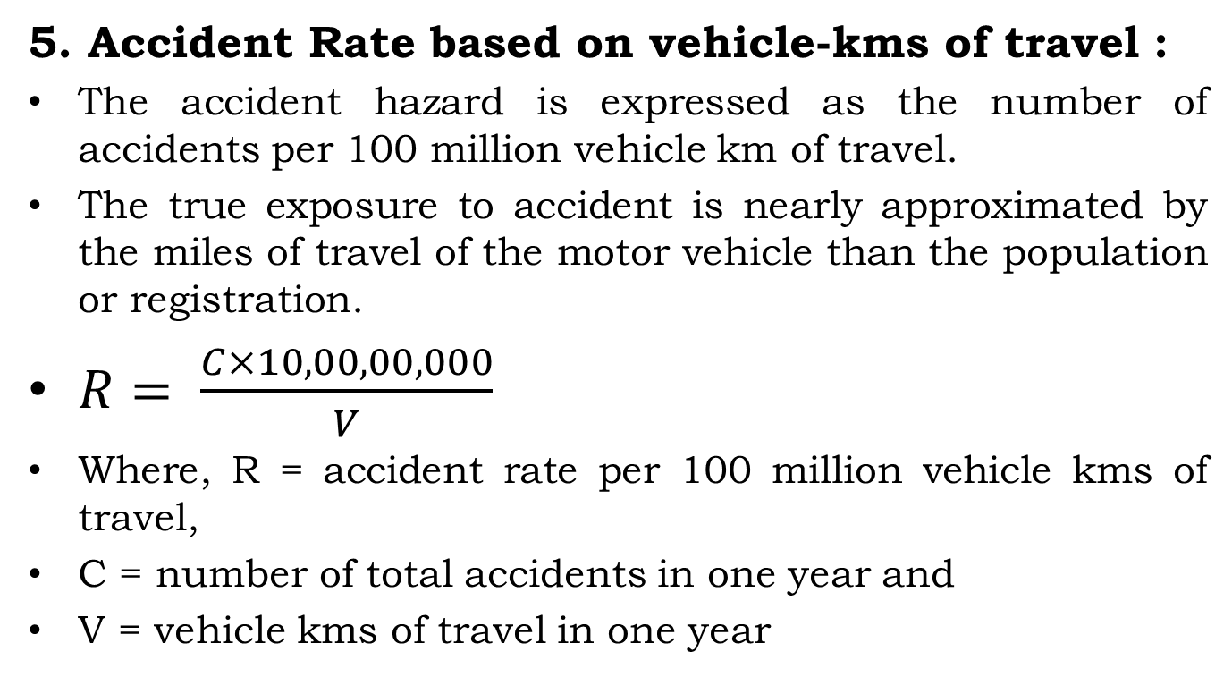
Accident Rate
5. Accident Rate based on vehicle-kms of travel :
The accident hazard is expressed as the number of accidents per 100 million vehicle km of travel.
The true exposure to accident is nearly approximated by the miles of travel of the motor vehicle than the population or registration.
$R= \frac{C×10,00,00,000}{V}$
Where, R = accident rate per 100 million vehicle kms of travel,
C = number of total accidents in one year and
V = vehicle kms of travel in one year

Slide 47
Accident Rate - Numerical
1. The Motor vehicle fuel consumption in a city is 5.082 million liters, there were 3114 motor vehicle fatalities, 355,799 motor vehicle injuries, 6,721,049 motor vehicle registrations and an estimated population of 18,190,238. Kilometer of travel per liter of fuel is 12.42 km/liter. Calculate registration death rate, population death rate and accident rate per vehicle km.

Slide 48
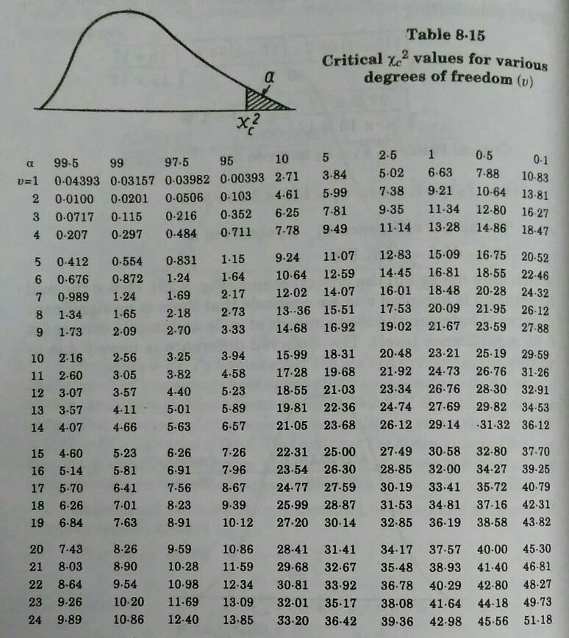

Slide 49
Analysis of Individual Traffic Accidents/Accident Reconstruction
Each road accident is to be analyzed by the traffic engineer to draw sound conclusions with reference to the major cause of the accident and other contributing causes.
Accident reconstruction deals with representing the accidents occurred in schematic diagram to determine the pre-collision speed which helps in regulating or enforcing rules to control or check movement of vehicles on road at high speed.

Slide 50
Analysis of Individual Traffic Accidents/Accident Reconstruction
The following data are required to determine the pre-collision speed:
1. Mass of the vehicle
2. Velocities after collision
3. Path of each vehicle as it approaches collision point

Slide 51
Analysis of Individual Traffic Accidents/Accident Reconstruction
A few simple types of vehicular accidents are listed under the following categories:
A moving vehicle collides with a stationary object which is collapsible (hollow electric pole)
A moving vehicle collides with a stationary object which is a rigid structure
A moving vehicle collides with a movable object like a parked car etc.
Two vehicles approaching from different directions collide at an intersection
Head-on collision of two vehicles approaching from opposite directions
Rear end collision of two moving vehicles.

Slide 52
Analysis of Individual Traffic Accidents/Accident Reconstruction
Hence summarizing the 6 types of collisions we discussed in the last slide:
The collision may be of two types collinear impact or angular collision. Collinear impact can be again divided into two types :
1. Rear end collision
2. Head-on collision.
It can be determined by two theories:
1. Poisson Impact Theory
2. Energy Theory

Slide 53
Important Assumptions in Accident Analysis
In order to simplify the analysis, the following assumptions are made:
Assumption 1:
When skid marks are present, the skid distances are measured to find the actual braking distances and it is assumed that 100% skid has occurred due to braking. When skid marks are not at all visible, it may be assumed as a free collision, without the brakes being applied or due to brake failure.

Slide 54
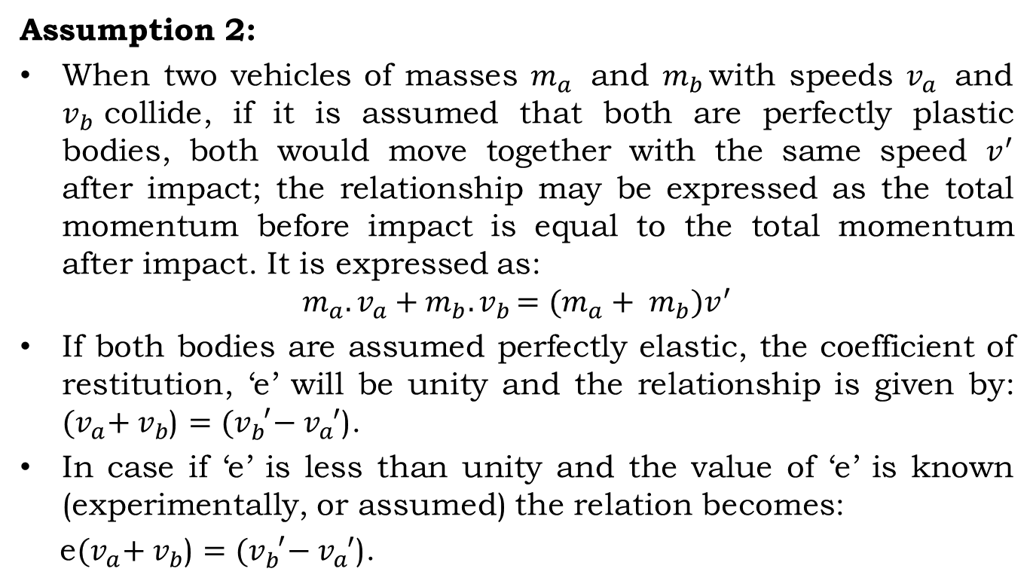
Important Assumptions in Accident Analysis
Assumption 2:
When two vehicles of masses $m_{a }$ and $m_{b }$with speeds $v_{a }$ and $v_{b }$collide, if it is assumed that both are perfectly plastic bodies, both would move together with the same speed $v^{′}$ after impact; the relationship may be expressed as the total momentum before impact is equal to the total momentum after impact. It is expressed as:
$$m_{a}.v_{a}+m_{b}{.v}_{b}=(m_{a}+ m_{b})v^{′}$$
If both bodies are assumed perfectly elastic, the coefficient of restitution, ‘e’ will be unity and the relationship is given by: ${(v}_{a}+ v_{b}$) $={(v}_{b}^{ ′}− v_{a}^{ ′}$).
In case if ‘e’ is less than unity and the value of ‘e’ is known (experimentally, or assumed) the relation becomes:
e${(v}_{a}+ v_{b}$) $={(v}_{b}^{ ′}− v_{a}^{ ′}$).

Slide 55
Important Assumptions in Accident Analysis
Assumption 3:
The impact of the vehicles may be either direct or oblique, at a known angle.
Assumption 4:
The friction coefficient of the pavement surface under the prevailing conditions may either be determined by field test or be suitably assumed. The friction coefficient is assumed uniform throughout the skid distance.

Slide 56
Road Accidents Safety Measures
The ultimate goal is to develop certain improvement measures to mitigate the circumstances leading to the accidents. The measures to decrease the accident rates are generally divided into three groups
Engineering
Enforcement
Education

Slide 57
Road Accidents Safety Measures Engineering
Road Design:
The geometric design features of the road such as sight distances, width of pavement, width of shoulders, horizontal and vertical alignment, intersection design details are to be checked and corrected if necessary.
Preventive Maintenance of Vehicles:
Braking and steering system, indicators, lighting system, condition of tyres and overall condition of vehicle needs to be checked and kept healthy.

Slide 58
Road Accidents Safety Measures Engineering
Before and After Studies
Visual guidance to a driver
Road Lighting:
Proper road lighting can decrease the chance of accidents
Lighting is particularly desirable at intersections, bridge sites and at places where there are restrictions to traffic movements.

Slide 59
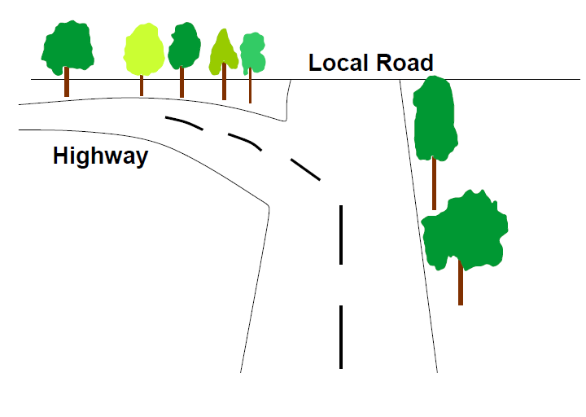
Bifurcation of Highway

Slide 60
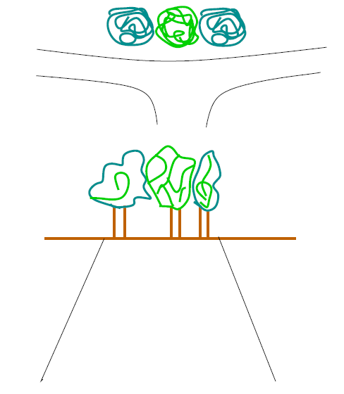
Road seems to be stopped by a dense forest

Slide 61
Road Accidents Safety Measures Engineering
Road Reconstruction:
The number of vehicles on the road increases from year to year, which introduces complications into organization of traffic, sharply reduces the operation and transportation characteristic of roads and lead to the growth of accident rate.
This leads to the need of re constructing road.
The places of accidents need to be properly marked so that the reconstruction can be planned accordingly.

Slide 62
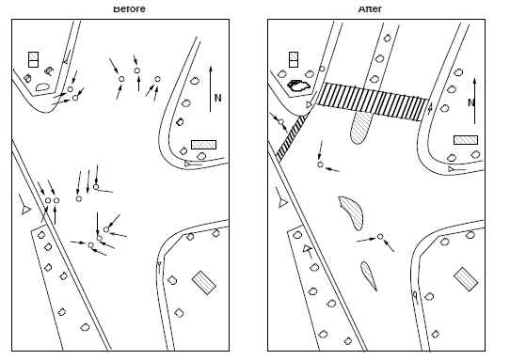
Road Reconstruction

Slide 63
Road Accidents Safety Measures Engineering
Channelization:
Channelization of traffic at intersection separates the traffic stream travelling in different direction, providing them a separate lane that corresponds to their convenient path and spreading as far as possible the points of conflict between crossing traffic streams.

Slide 64
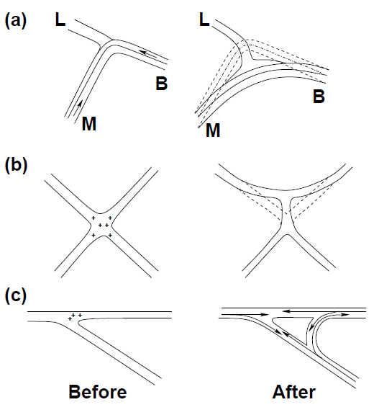
Channelization

Slide 65
Road Accidents Safety Measures Engineering
Traffic Control Devices/Road Signs:
Existing Signals may be redesigned or new signals introduced if necessary at uncontrolled intersections.
All traffic control device like speed limit signs, warning signs are to be installed where ever necessary.
Road signs are integral part of safety as they ensure safety of the driver himself (warning signs) and safety of the other vehicles and pedestrians on road.
Driver should be able to read the sign from a distance so that he has enough time to understand and respond.
It is essential that they are installed and have correct shape, colour, size and location.
It is required to maintain them as well, without maintenance in sound condition just their instalment would not be beneficial.

Slide 66
Road Accidents Safety Measures - Enforcement
The various measures of enforcement that may be useful to prevent accidents at spots prone to accidents are enumerated below.
These rules are revised from time to time to make them more comprehensive.
(a) Speed Control:
Installation of speed limits and warning signs at all critical locations of the roads
Checking over-speeding of vehicles by conducting surprise spot speed tests and levying fines/ legal action on drivers who violate speed limits.
Installation of Speed breakers for control of vehicular speeds at intersections and residential areas.

Slide 67
Road Accidents Safety Measures - Enforcement
(b) Training and supervision:
The transport authorities should be strict while issuing licence to drivers of public service vehicles and taxis.
Driving licence of the driver may be renewed after specified period, only after conducting some tests to check whether the driver is fit.
(c) Medical check
The drivers should be tested for vision and reaction time at prescribed intervals of time

Slide 68
Road Accidents Safety Measures - Education
Education of road users:
The passengers and pedestrians should be taught the rules of the road, correct manner of crossing etc. by introducing necessary instruction in the schools for the children and by the help of posters exhibiting the serious results due to carelessness of road users.
Safety drive
Imposing traffic safety week when the road users are properly directed by the help of traffic police as a means of training the public.
Training courses and workshops should be organized for drivers in different parts of the country.

Slide 69
Question Bank
Why is the problem of accident is very acute in road transportation ?
Enlist six objectives of road accidents.
Explain how improper Road design and its condition cause accidents.
Discuss how Road user contributes in Road Accidents.
Discuss how the ‘Vehicle’ contributes in road accidents.
Discuss how Road Traffic and Environmental Factors cause Road Accidents.
Enlist the five steps involved in accident data studies.
Discuss accident data collection as per IRC:53-1982.
Explain the ‘Engineering uses’ of Accident Data Collection.

Slide 70
Question Bank
Explain the ‘Enforcement uses’ of Accident Data Collection.
With a near sketch explain Condition Diagram
With a near sketch explain Collision Diagram

